Slide 1
Analyzing Individual Preparedness for Enhanced Disaster Management
-By
TEAM 5
APARNA NIDAMANURI
DIVYA MEDAPUREDDY

Slide 2
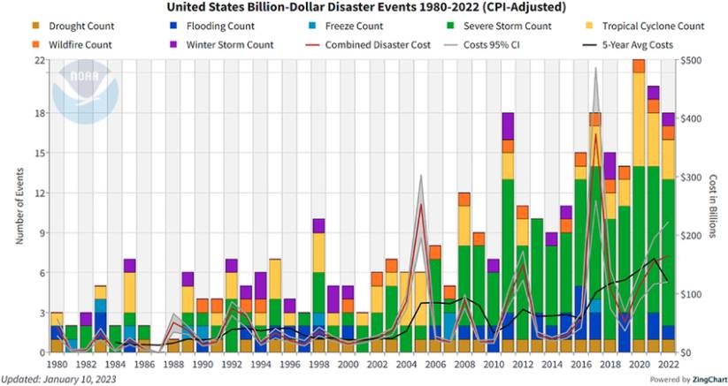
The Rising Threat: Disasters in the U.S.

Slide 3
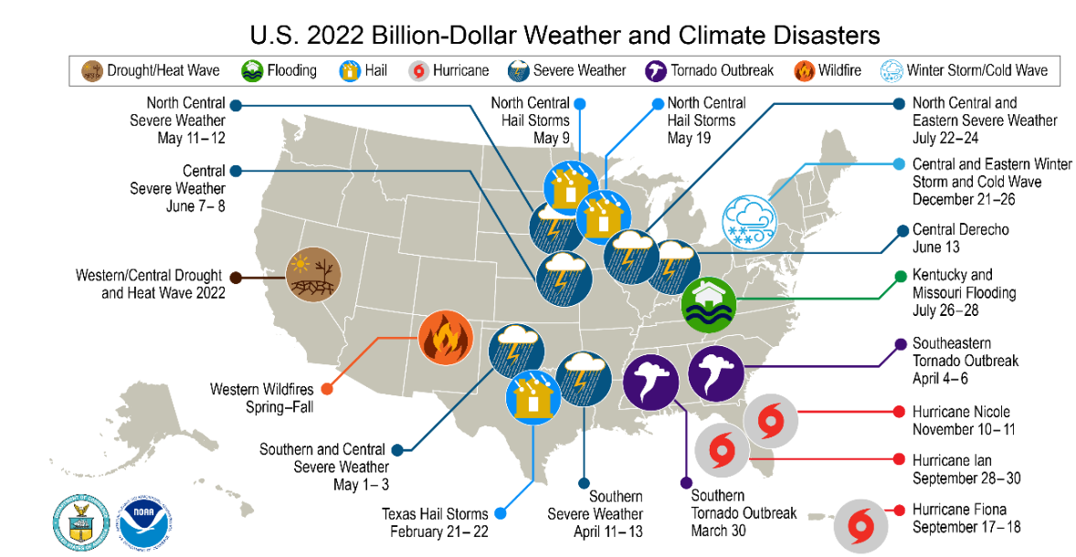
The Rising Threat: Disasters in the U.S.

Slide 4
Problem Statement
Are We Ready? The Challenge of Individual Preparedness
Disasters are becoming more frequent and severe, posing a significant threat to communities.
Despite the growing risks, many individuals remain unprepared for these events.
A critical gap exists in our understanding of the factors influencing individual preparedness behaviors.
Project Goal:
Analyzing the factors that influence how prepared people are for disasters.
Leveraging this knowledge to develop more effective strategies to promote preparedness and ensure safer communities.

Slide 5
Understanding Preparedness: A Review of Existing Research
“A Data-Driven Model for Infrastructure Resilience”
Realistic scenarios for resilience planning using big data, IoT, and AI.
Understanding disruptive events impacting infrastructure systems.
Leveraging historical records, sensor data, and simulations.
"Machine Learning and Simulation for Disaster Preparedness"
Predicting preparedness behaviors using FEMA National Household Survey Data.
Identifying factors influencing household readiness.
Enhancing disaster preparedness assessments.
"Leveraging ML and Simulation for Household Preparedness"
Integrated framework predicting household disaster preparedness levels.
Relationships between demographics, experiences, and preparedness.
Accurate forecasting for various disaster types.

Slide 6
Our Data Source - The 2023 FEMA National Household Survey (NHS)
The FEMA National Household Survey (NHS) is a comprehensive survey conducted by Federal Emergency Management Agency to assess disaster preparedness, response, and recovery efforts at the household level for the year 2023.
Core survey information on various disasters (coastal flooding, earthquakes, wildfires, etc.)
Geographic data (state, county, zip code)
Disaster awareness and perception
Preparedness actions taken by respondents
Socioeconomic factors (age, education, income)
Vulnerable population indicators (disability status)
Demographics (language, rurality)
Housing characteristics (ownership, type)

Slide 7
Data Preprocessing
Created a target variable - Preparedness level (1-5) based on the preparation action taken by individuals.
Created new variables to indicate if the respondent registered for alerts or not and also awareness score using the awareness sources.
Handled the data imbalance by merging few classes of target variable.
After data preprocessing, we have the following features: Sample, State, Geographic Division, Census Region, Zipcode, County, Disaster Preparation Actions, Disaster Perception, Disaster Experience, Age, Employment, Income, Sex, Education, Ethnicity, Awareness Score, Disability, Care Needs, Number of Adults, Number of Children, Homeownership, Rurality, Socioeconomically Disadvantaged, Registered for Alerts and Preparedness Levels (0- Low/Contemplation, 1- Medium/Preparation and 2- High/Action).

Slide 8
Unveiling the Why: Our Research Questions
Demographic Factors & Preparedness Levels: How do demographics relate to preparedness in disaster-prone regions?
Distribution of Preparedness Levels: How are preparedness levels distributed across states?
Influence of Awareness & Past Experiences: How awareness and past experiences affect preparedness levels?
Contributions to Disaster Management: How can insights from preparedness behaviors inform disaster management?

Slide 9
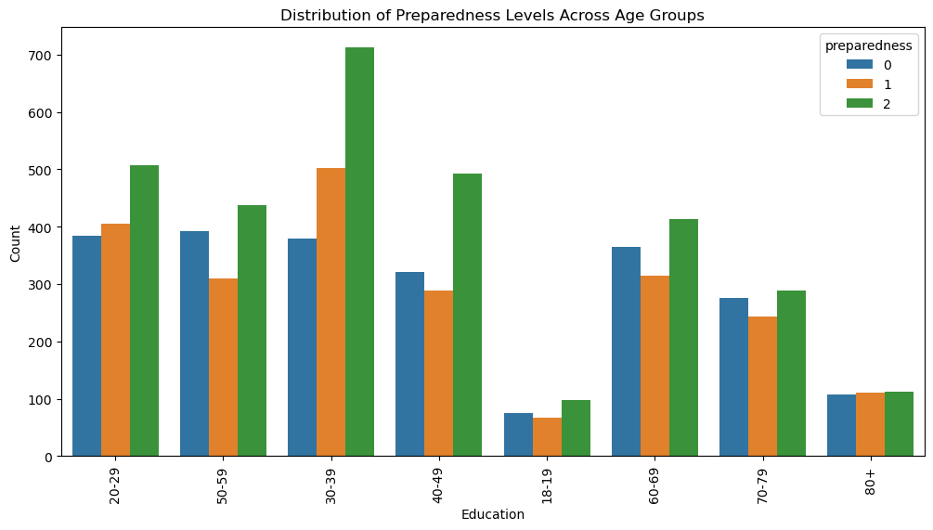
Age with Preparedness Levels

Slide 10
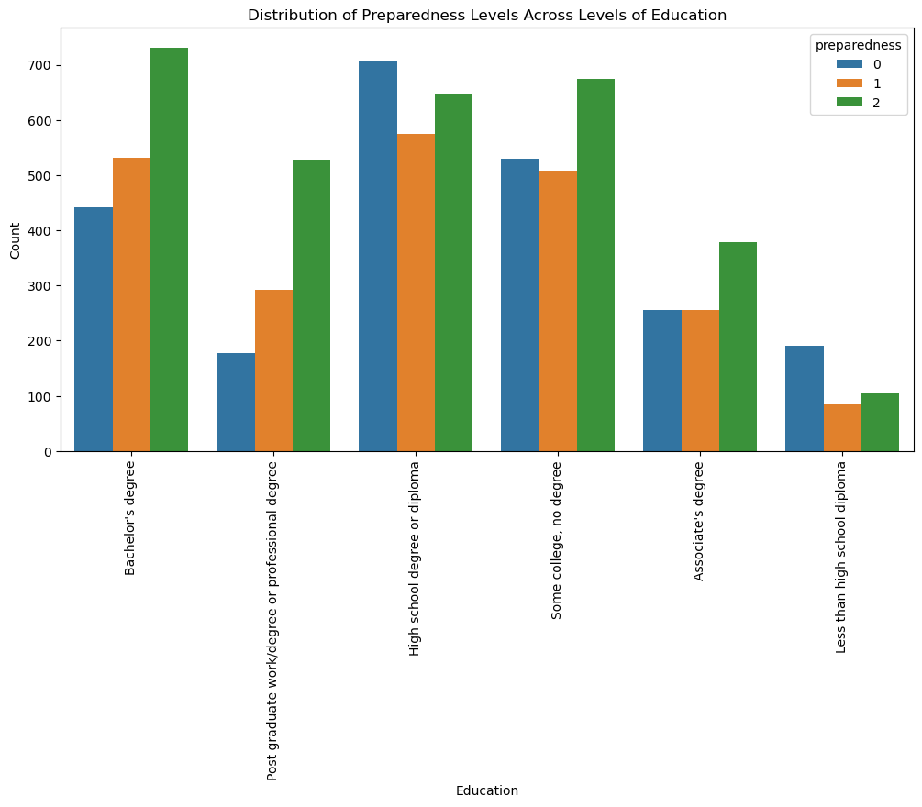
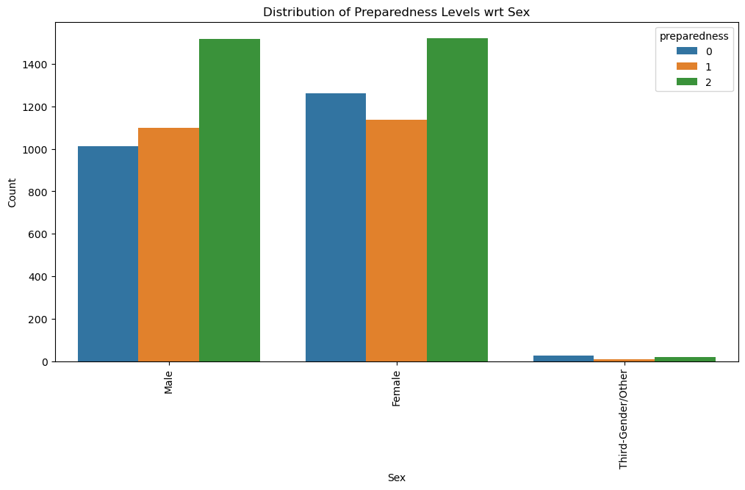
Gender and Education with Preparedness Levels

Slide 11
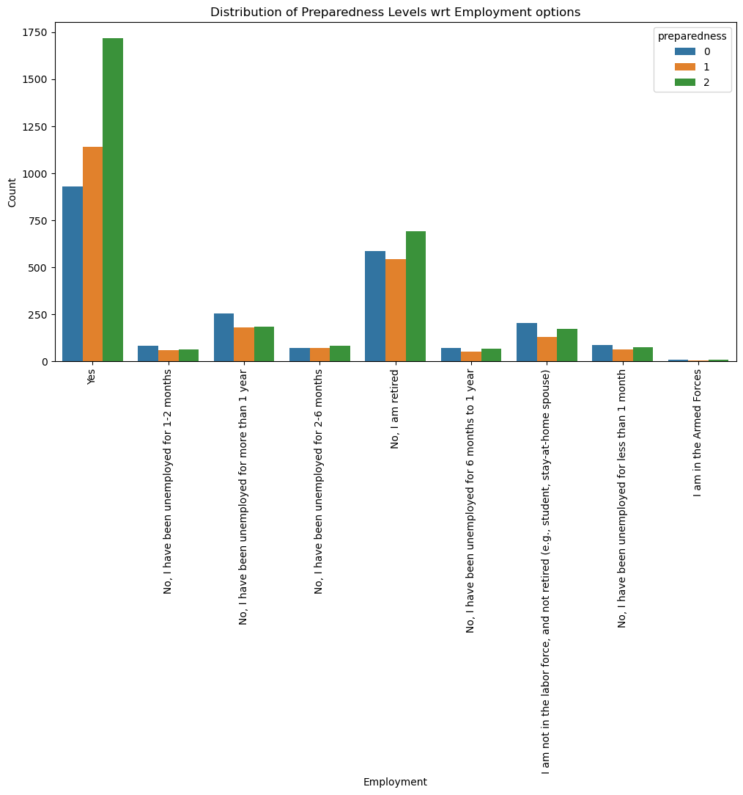
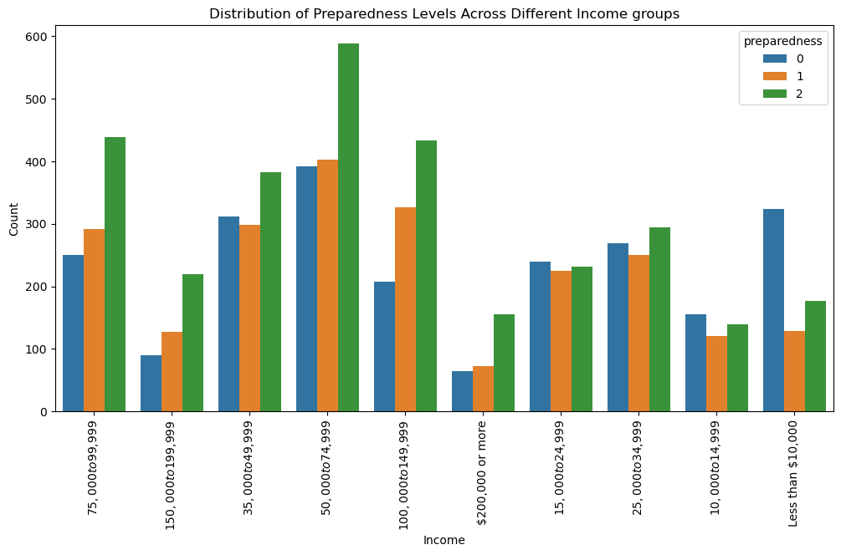
Employment and Income with Preparedness Levels

Slide 12
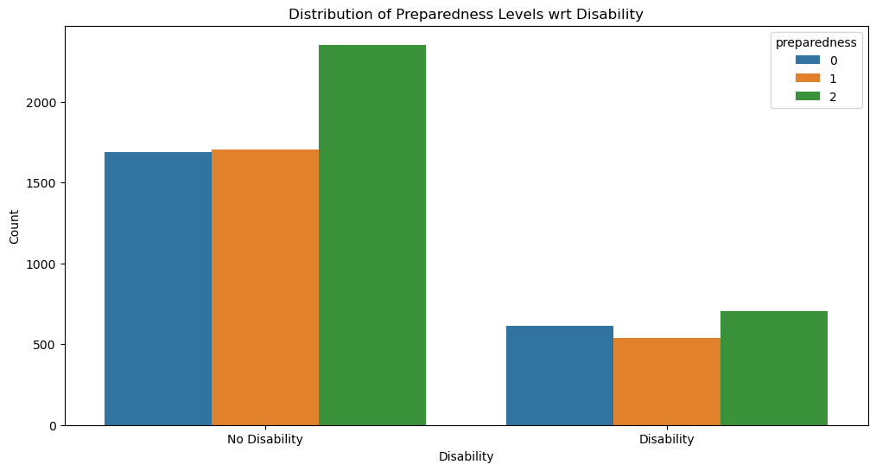
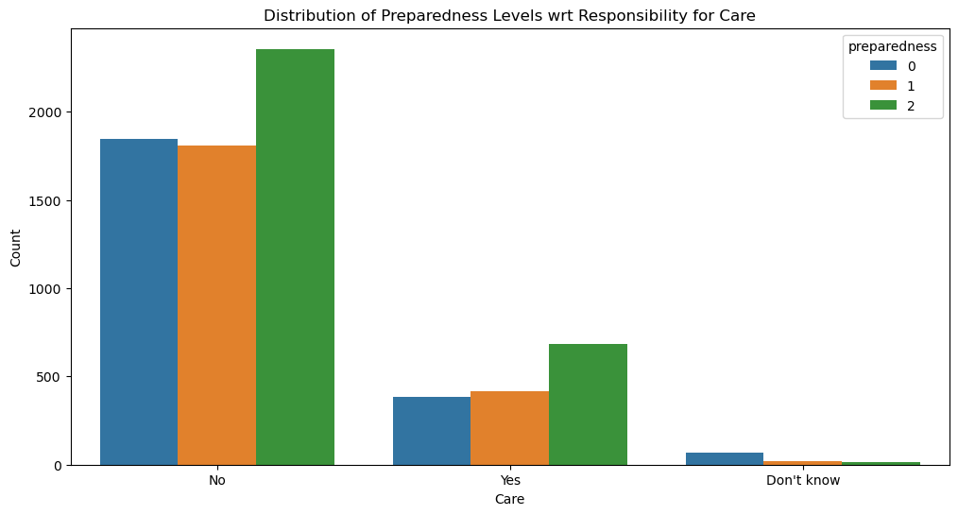
Disability and Care with Preparedness Levels

Slide 13
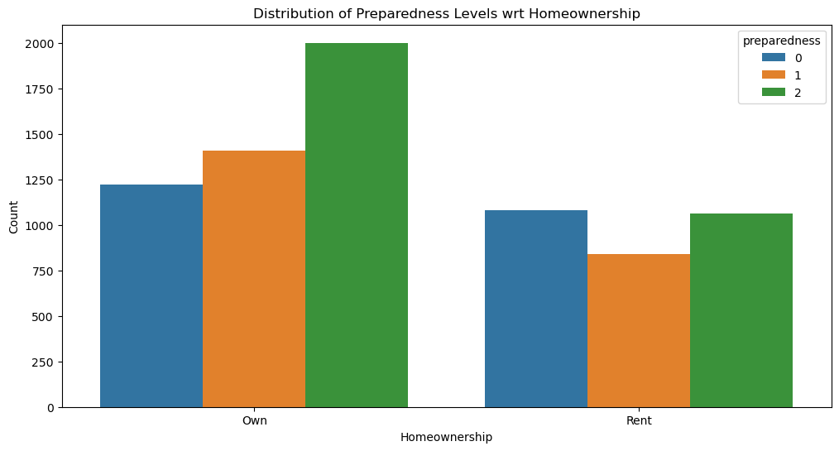
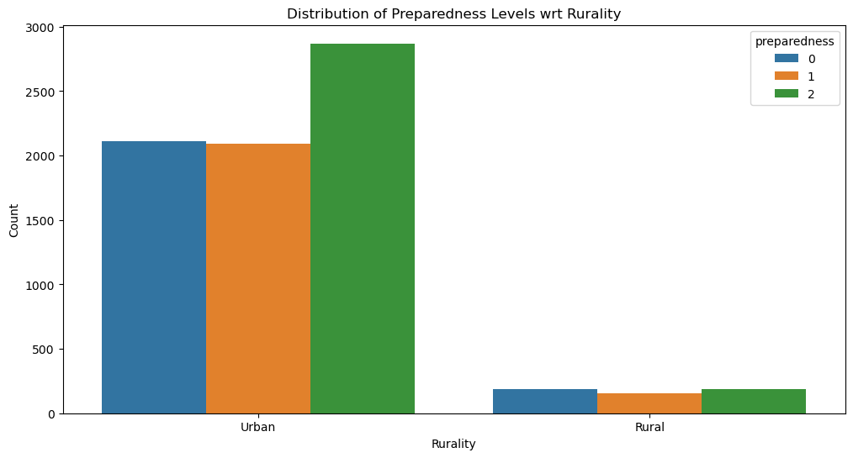
Home Ownership and Rurality with Preparedness Levels

Slide 14
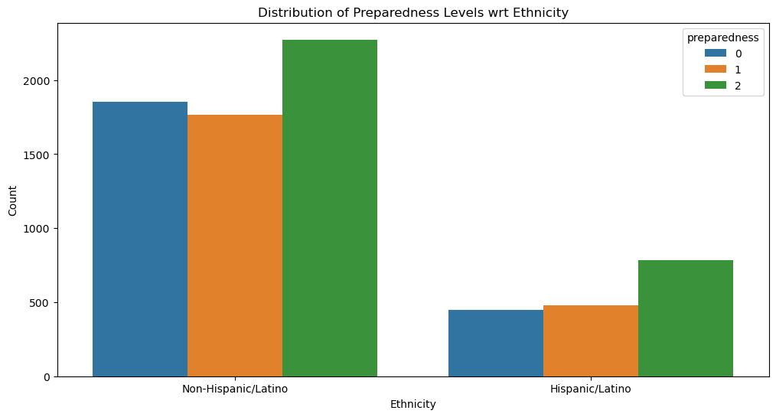
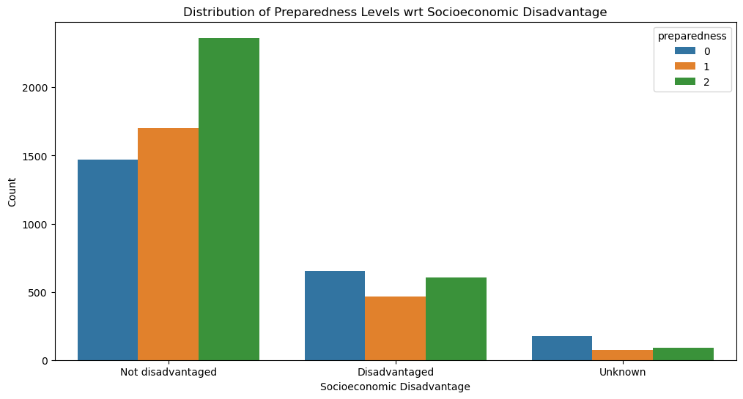
Ethnicity and Socioeconomic Status with Preparedness Levels

Slide 15
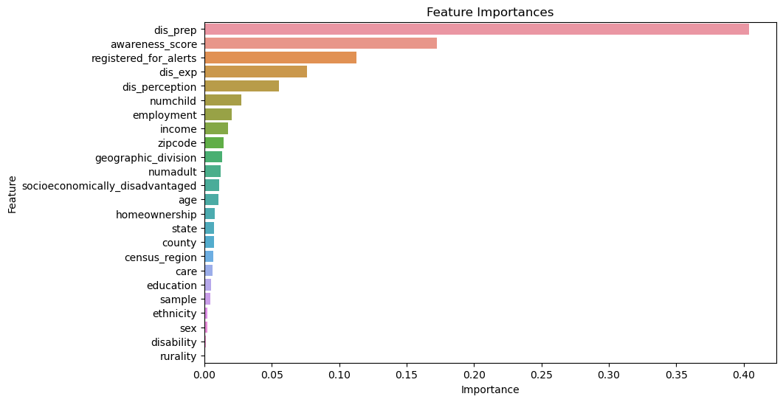
Demographic Factors and Preparedness

Slide 16
Statistical Significance of Preparedness Factors
Positive Influence:
Homeownership: Higher preparedness levels (coefficient: 0.21, p-value: 8.08e-20).
Registered for Alerts: Significantly higher preparedness (coefficient: 1.19, p-value: 5.82e-80).
Income: Weak positive correlation with preparedness (coefficient: 0.02, p-value: 5.19e-07).
Age: Slightly positive association with older age (coefficient: 0.06, p-value: 3.84e-06).
Ethnicity: Specific ethnic groups exhibit higher preparedness (coefficient: 0.06, p-value: 1.50e-07).
Negative Influence:
Past Disaster Experience: Negative association (coefficient: -0.37, p-value: 6.39e-109).
Disability: Lower preparedness levels (coefficient: -0.19, p-value: 0.01).
Caregiver Responsibilities: Lower preparedness (coefficient: -0.11, p-value: 6.67e-12).
Education: Weak negative association (coefficient: -0.02, p-value: 0.62).
Additional Factors:
Number of adults and children in household, employment status, geographic location, and socioeconomic status also influence preparedness levels.

Slide 17
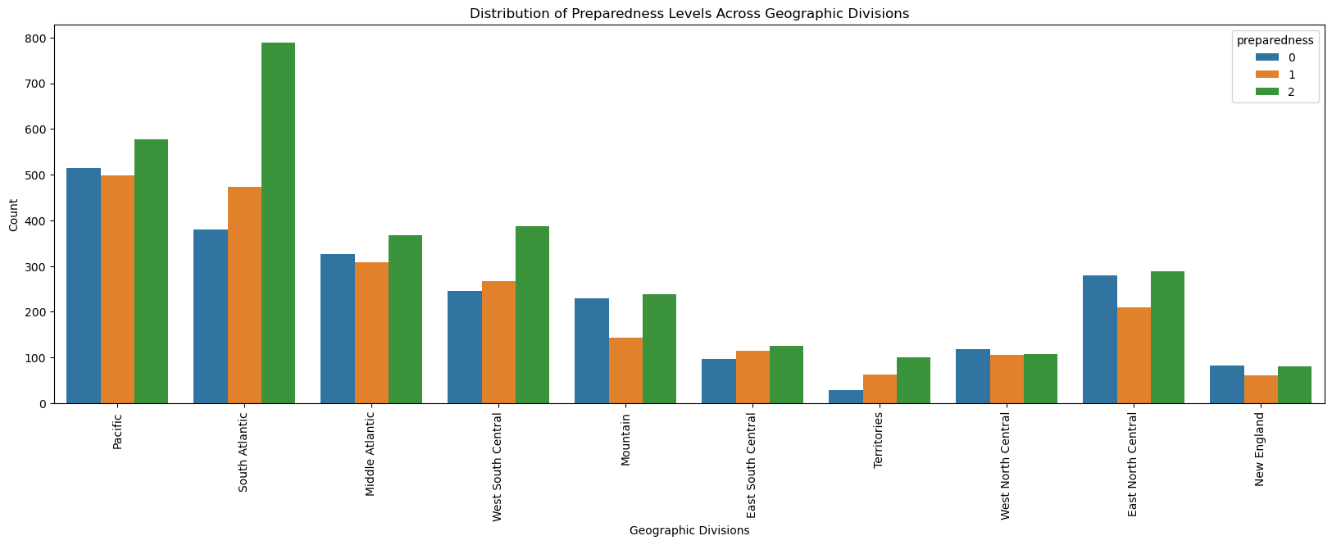
Distribution of Preparedness Levels across Geographical Divisions

Slide 18
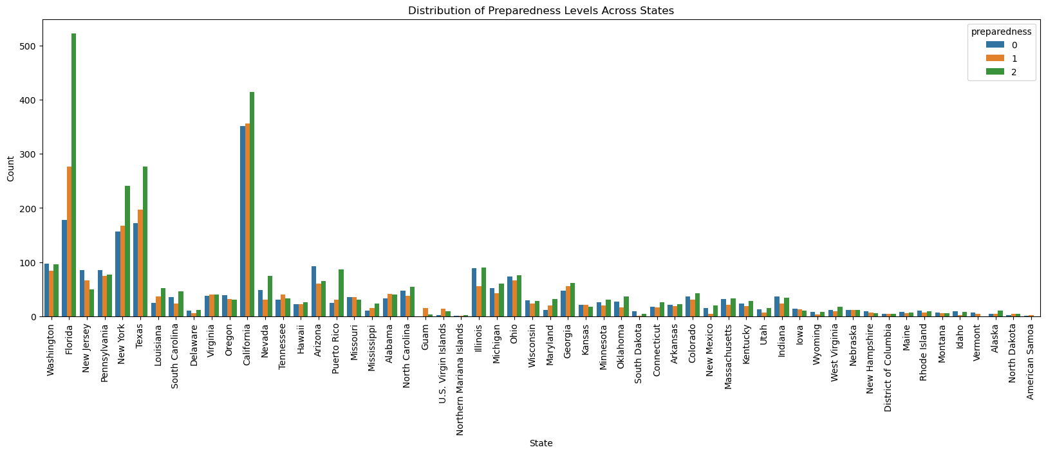
Distribution of Preparedness Levels across States

Slide 19
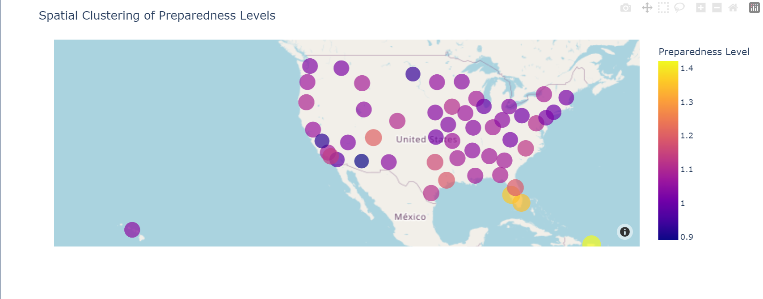
Average Level of Preparedness across States

Slide 20
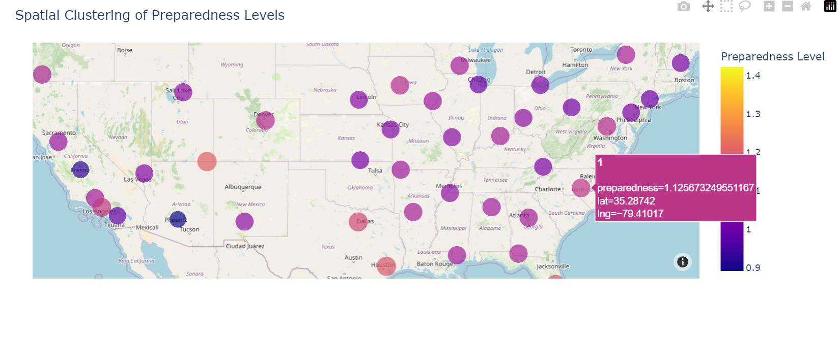
Average Level of Preparedness across States

Slide 21
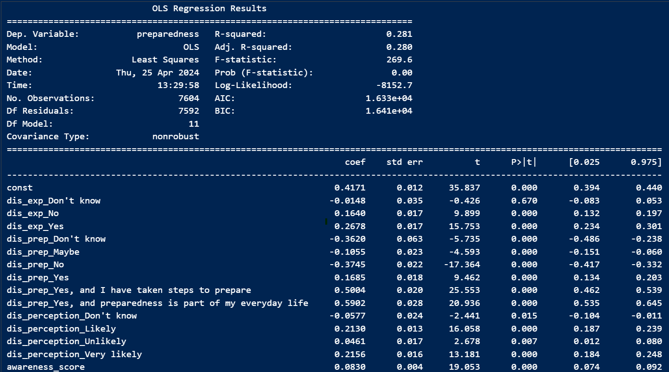
Influence of Awareness, Past Experience and Perception on Preparedness

Slide 22
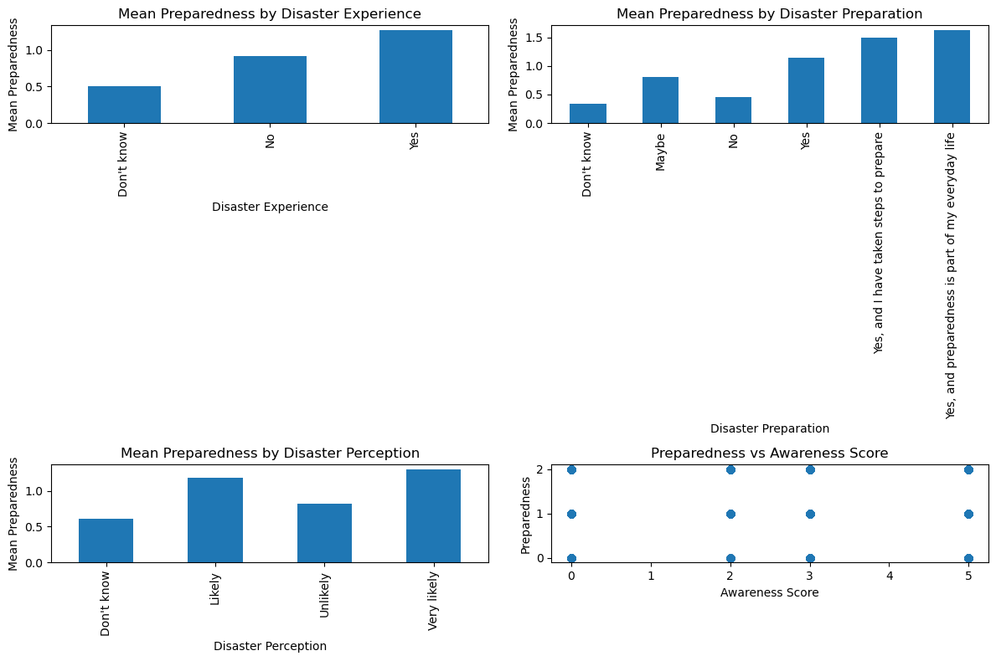
Influence of Awareness, Past Experience and Perception on Preparedness

Slide 23
Contributions to Disaster Management Strategies
Targeted Outreach:
Understand factors influencing preparedness across demographics and locations.
Develop targeted outreach programs to reach those most in need.
Address specific preparedness gaps.
Resource Allocation:
Identify areas or communities requiring focused resource allocation.
Allocate resources effectively for preparedness initiatives.
Promoting Inclusive Preparedness:
Consider disabilities and caregiving responsibilities.
Ensure inclusivity in disaster preparedness programs.
Educational Programs:
Leverage education to raise awareness and knowledge.
Educate communities about disaster preparedness.
Financial Considerations:
Recognize financial limitations faced by certain populations.
Offer low-cost or free preparedness resources.

Slide 24
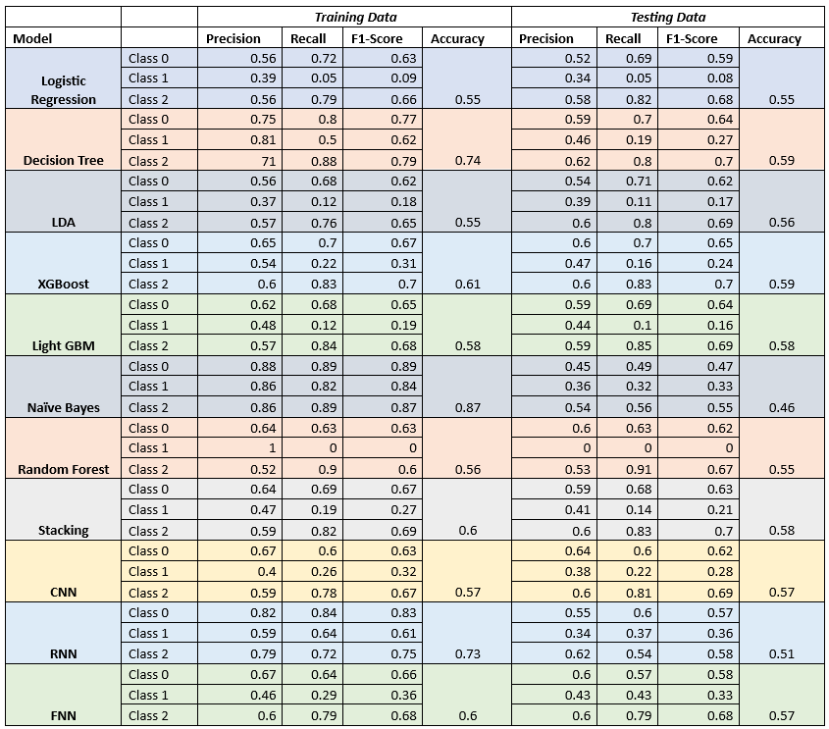
Model Performance Analysis

Slide 25
Key Takeaways
Individual preparedness significantly impacts disaster resilience
Understanding demographics is crucial for effective outreach
Financial considerations and accessibility require focused efforts
Education and preparedness have a complex relationship
Multi-faceted approach is key
Addressing past disaster experiences needs sensitivity

Slide 26
THANK YOU

